Slide 1
Geographical Weighted Regression (GWR)
Behzad Kiani
Research Fellow
UQ Centre for Clinical Research, Faculty of Medicine, The University of Queensland, Brisbane, Australia
Email: B.Kiani@uq.edu.au

Slide 2

Acknowledgement of Country
The University of Queensland (UQ) acknowledges the Traditional Owners and their custodianship of the lands on which we meet.
We pay our respects to their Ancestors and their descendants, who continue cultural and spiritual connections to Country.
We recognise their valuable contributions to Australian and global society.
The Brisbane River pattern from A Guidance Through Time by Casey Coolwell and Kyra Mancktelow.
1

Slide 3
Who am I?
B.S and Master in IT
PhD in Medical Informatics in Iran at the end of 2017
Assistant Professor in Iran (2018-2022)
Postdoctoral Researcher in Canada (2022-2023)
Research Fellow in ODeSI Team at UQCCR (2023-now)
2

Slide 4
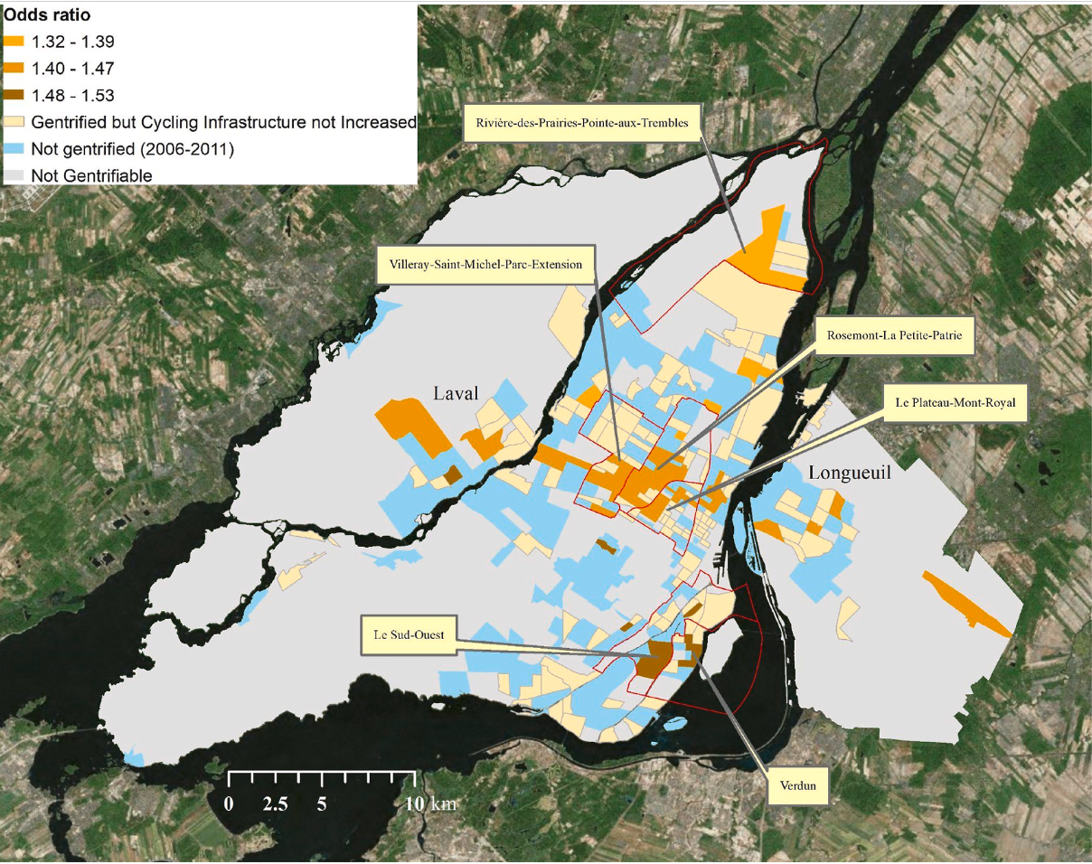
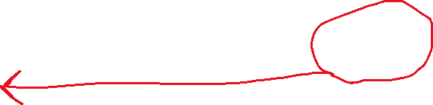
The idea of local indicators
Example:
The degree of association between gentrification from 2006 to 2011 and the subsequent increase in cycling infrastructure from 2011 to 2016 depends on census tracts (locations).
The strongest
association!
3
Behzad Kiani, Hiroshi Mamiya, Benoit Thierry, Caislin Firth, Daniel Fuller, Meghan Winters, Yan Kestens,The temporal sequence between gentrification and cycling infrastructure expansions in Montreal, Canada,Habitat International, Volume 139, 2023, 102899, ISSN 0197-3975, https://doi.org/10.1016/j.habitatint.2023.102899.

Slide 5
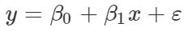
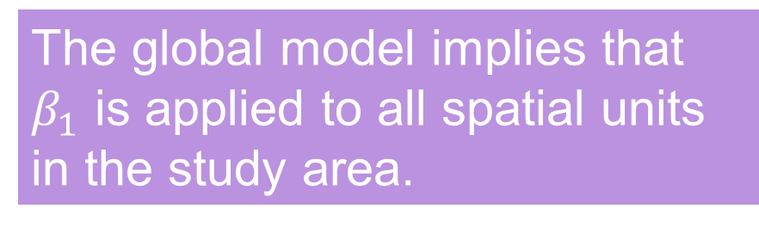
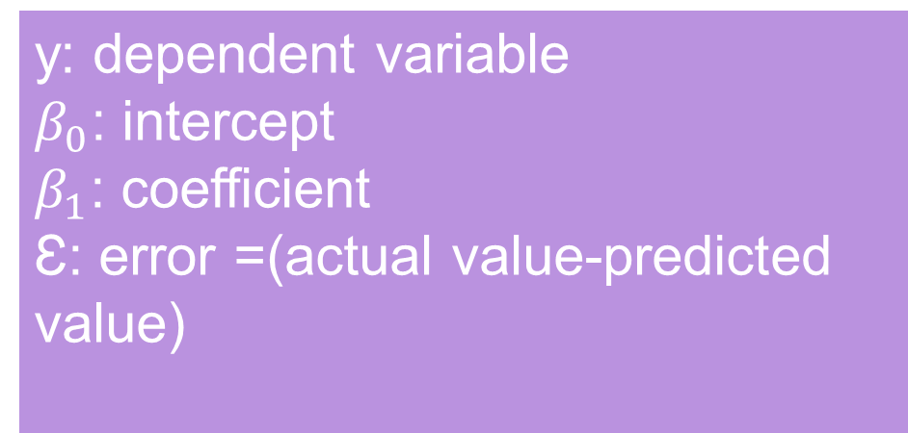
Global regression models
y: dependent variable
$β_{0}$: intercept
$β_{1}$: coefficient
Ɛ: error =(actual value-predicted value)
The global model implies that $β_{1}$ is applied to all spatial units in the study area.
Assumption: the relationship between x and y is stationary.
4

Slide 6

Tutorial
https://crd230.github.io/gwr.html
5

Slide 7
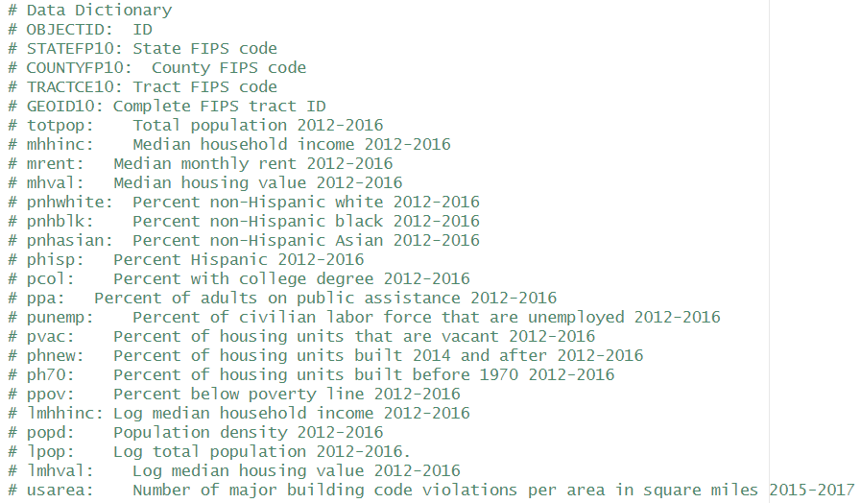
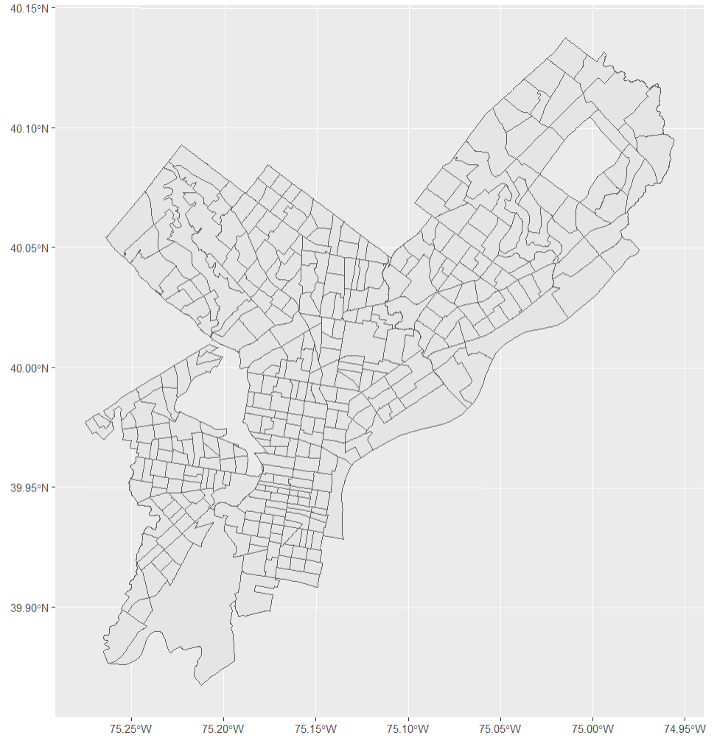
Dataset
6

Slide 8
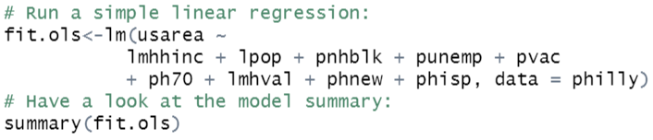
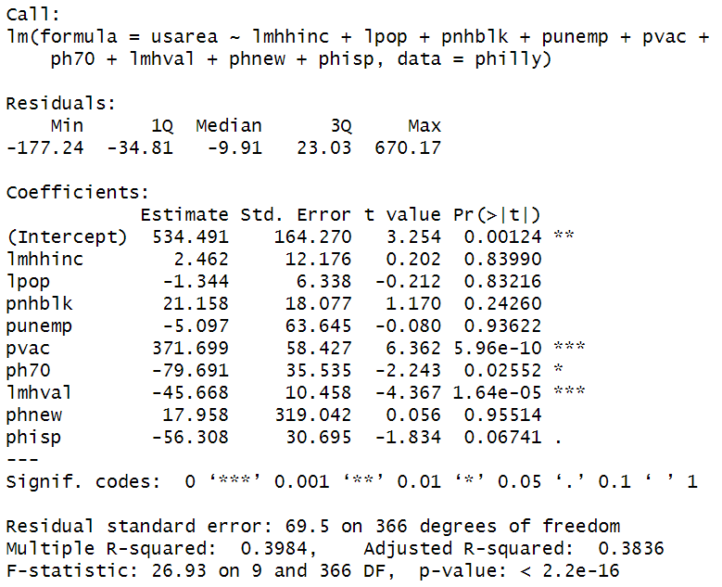
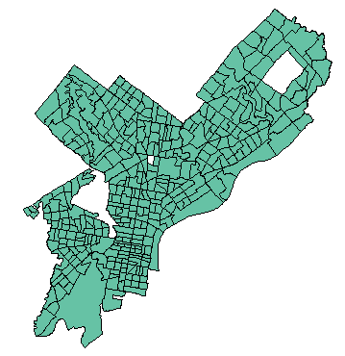

let’s do the global model in R
Same coefficient for all geographical areas.
This model assumes spatial homogeneity in these relationships.
7

Slide 9
Stationary can be a weak assumption!
Does x affect y differently at different geographic locations?
If the global regression estimates that β1= b, are there locations in the data where β1 does not equal b?
8

Slide 10
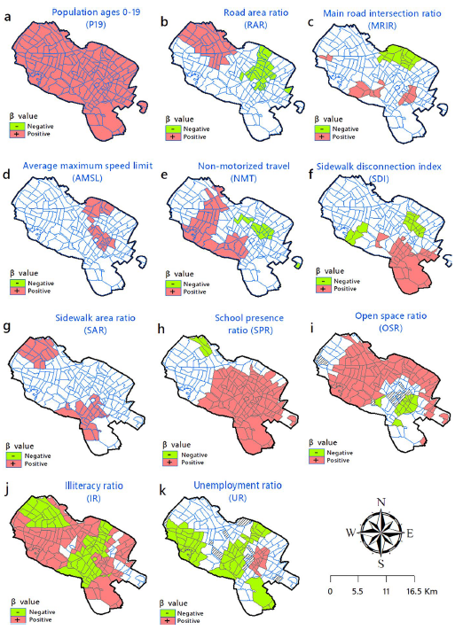
What is the objective if the assumption is not true?
Consider the unequal spatial distribution (spatial heterogeneity) in the relationship between two variables x and y.
Method: Geographical Weighted Regression
Choropleth maps of the distribution of the local coefficient (β) based on GWPR modelling.
Outcome is pedestrian motor vehicle collisions calculated for the pedestrian age group of 0–18 years old in Mashhad, Iran.
9
Soroori, E., Kiani, B., Ghasemi, S. et al. Spatial Association Between Urban Neighbourhood Characteristics ‎‎and ‎‎‎Child Pedestrian–Motor Vehicle Collision‎s. Appl. Spatial Analysis (2023). https://doi.org/10.1007/s12061-023-09519-w

Slide 11
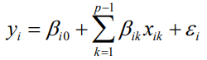
Geographical Weighted Regression (1)
Where y_{i} is the dependent variable value at location i, x_{ik} is the value of the kth covariate at location i, β_{i0} is the intercept, β_{ik} is the regression coefficient for the kth covariate, p is the number of regression terms, and ε_{i} is the random error at location i.
10
https://rss.onlinelibrary.wiley.com/doi/epdf/10.1111/1467-9884.00145

Slide 12
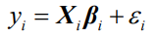
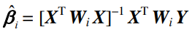
Geographical Weighted Regression (2)
Estimation
1)
Where β_{i} is a column vector of regression coefficients and X_{i} is a row vector of explanatory variables at location i.
The vector of estimated regression coefficients at location i is:
2)
The weight matrix must be calculated at each location before the local regression coefficients can be estimated with equation 2.
11
https://rss.onlinelibrary.wiley.com/doi/epdf/10.1111/1467-9884.00145

Slide 13
GWR’s critical questions!
Critical questions:
How do we determine which locations are considered neighbours?
In what way do the neighbours of a specific area "a" influence its regression equation? We should consider the first law of geography!
12
https://rss.onlinelibrary.wiley.com/doi/epdf/10.1111/1467-9884.00145

Slide 14


Neighbourhood selection
We need to define spatial relationships!
13

Slide 15
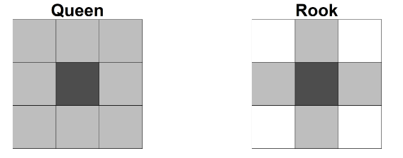
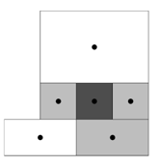
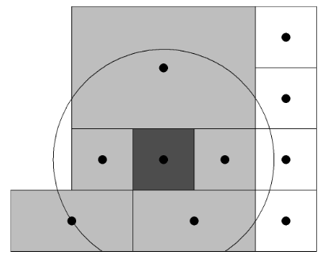
Neighbourhood selection (2)
Neighbours based on contiguity
Neighbours based on K-nearest neighbours
Neighbours based on specific distance
14
https://www.paulamoraga.com/book-spatial/spatial-neighborhood-matrices.html
3

Slide 16
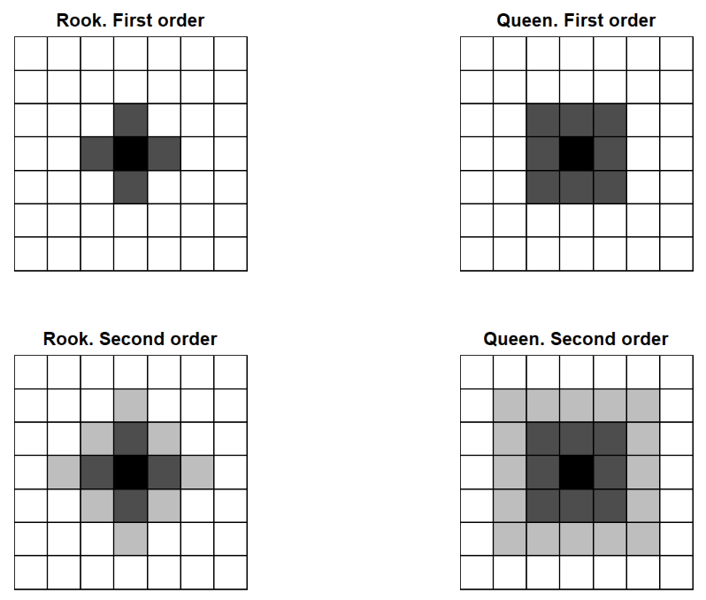
Neighbourhood selection (3)
Rook and Queen neighbours of first (dark gray) and second (light gray) order.
https://www.paulamoraga.com/book-spatial/spatial-neighborhood-matrices.html
15

Slide 17
GWR’s critical questions!
Critical questions:
How do we determine which locations are considered neighbours?
In what way do the neighbours of a specific area "a" influence its regression equation?
16

Slide 18
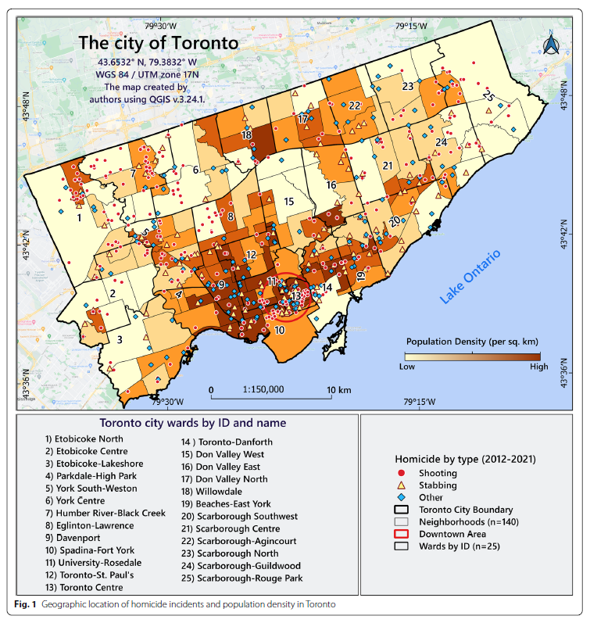
Different influence of neighbors
Tobler's first law of geography states that everything is related to everything else, but near things are more related to each other.
A weighting matrix is needed to run a GWR analysis.
The weighting matrix is a diagonal matrix, with each diagonal element w_{ij}
being a function of the location of the observation.
17
Mohammadi, A., Bergquist, R., Fathi, G. et al. Homicide rates are spatially associated with built environment and socio-economic factors: a study in the neighbourhoods of Toronto, Canada. BMC Public Health 22, 1482 (2022). https://doi.org/10.1186/s12889-022-13807-4

Slide 19
GWR terminology for neighborhood
selection and weighting
1) The bandwidth: h
2) The kernel density function assigning weights w_{ij}
18

Slide 20
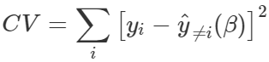
The bandwidth: h
R uses two methods:
1) The first uses a cross-validation method to choose the optimal kernel bandwidth:
where y^_{≠i}(β) is the fitted value of y_{i} with the observations for point i omitted from the calibration process. Here, are trying to find the h that minimizes CV.
2) The other method chooses a bandwidth that minimizes the Akaike Information Criterion (AIC).
19

Slide 21
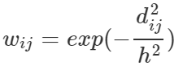
Kernel density function (1)
The kernel density function determines the weight assigned to neighbouring units.
A common density function is a Gaussian weighting function:
Where d_{ij} is the distance between location i and j and h is the bandwidth.
20

Slide 22
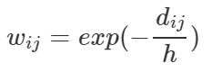
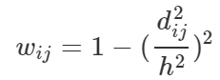
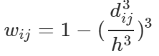
Kernel density function (2)
Exponential function:
Bi-square function:
Tri-cube function:
21

Slide 23
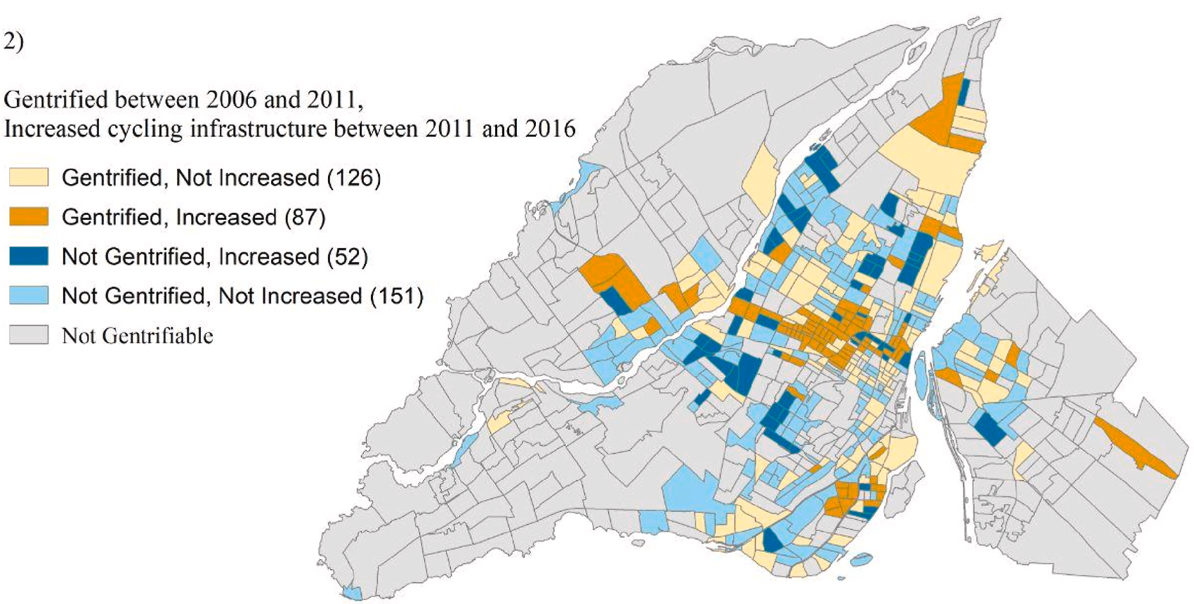
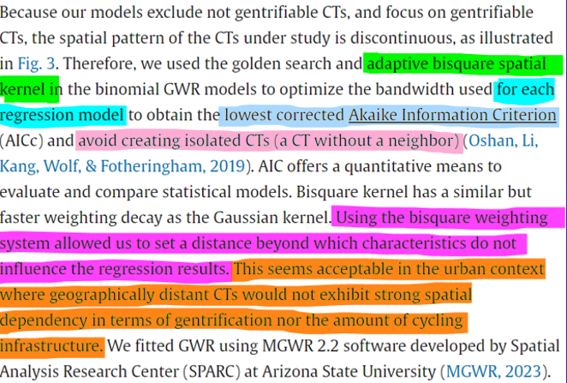


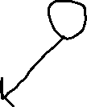
Here is an example of a published paper discussing the rationale behind choosing bi-square function instead of Gaussian function:
Be careful: this can be an isolated CT in GWR modelling!
22
Behzad Kiani, Hiroshi Mamiya, Benoit Thierry, Caislin Firth, Daniel Fuller, Meghan Winters, Yan Kestens,The temporal sequence between gentrification and cycling infrastructure expansions in Montreal, Canada,Habitat International, Volume 139, 2023, 102899, ISSN 0197-3975, https://doi.org/10.1016/j.habitatint.2023.102899.

Slide 24


Fixed vs. adaptive bandwidth!
Fixed bandwidth: the same bandwidth is applied uniformly to all locations.
Adaptive bandwidth: it adjusts the size of the bandwidth based on local characteristics, so, there are many bandwidths!
Adoptive bandwidth means that areas with more data points or higher data density may have a smaller bandwidth, allowing for a more localized analysis, while areas with sparse data may have a larger bandwidth to incorporate a broader set of neighbours.
23

Slide 25
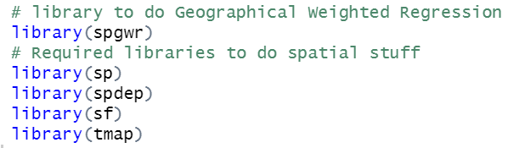
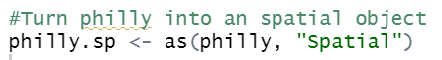
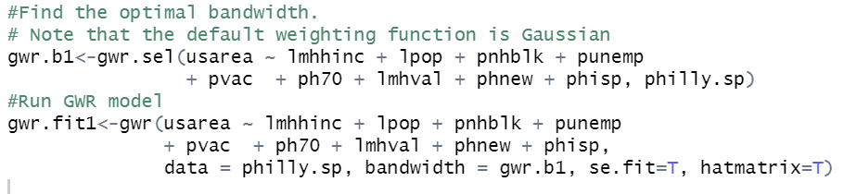
Let’s do the GWR: R codes
24

Slide 26
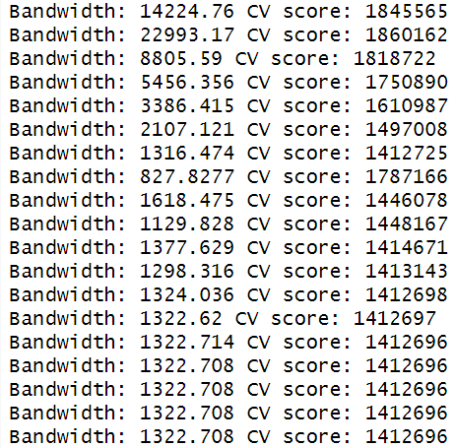
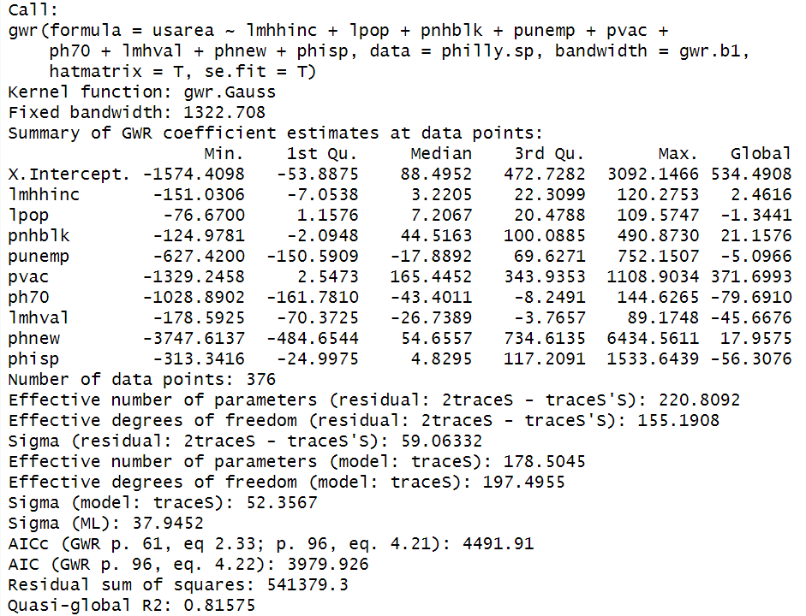

Let’s do the GWR: R results
Optimal fixed bandwidth!
25

Slide 27
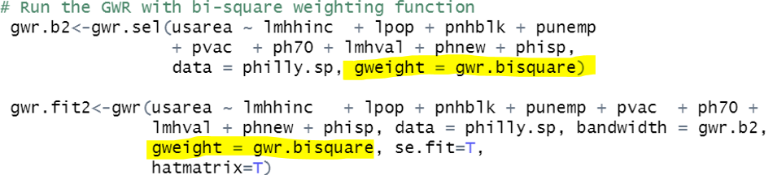
Let’s do the GWR with bi-square weighting function: R codes
26

Slide 28
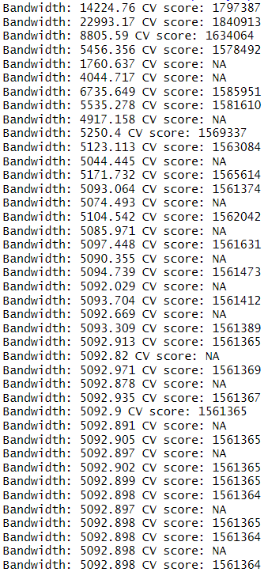
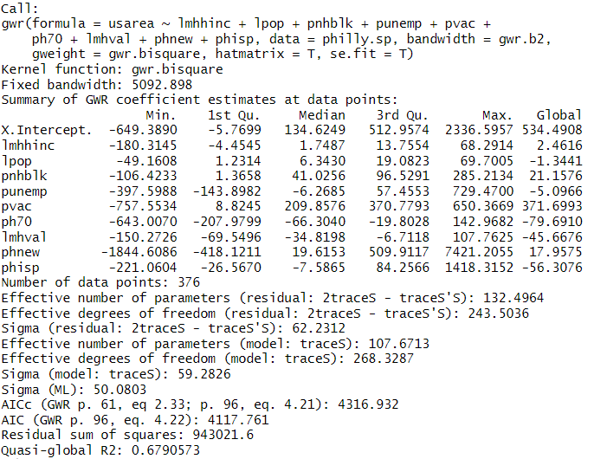

The results of GWR with bi-square weighting function
27

Slide 29
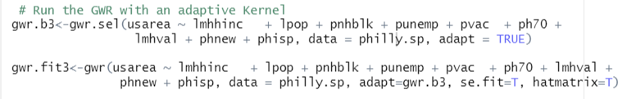
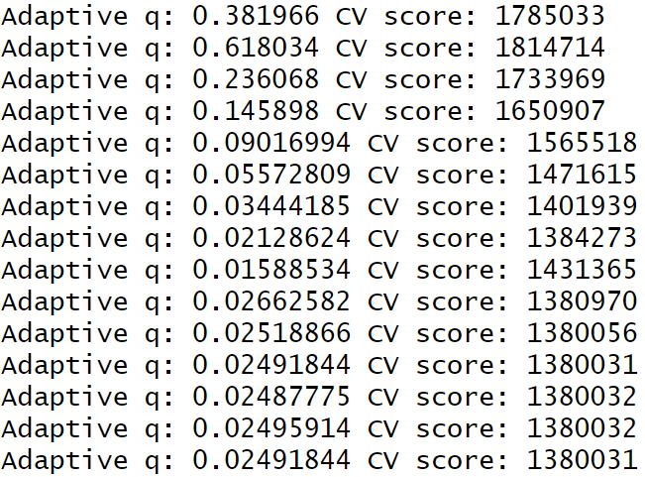


Let’s do the GWR with adaptive bandwidth
This is a very low value
compared to fixed bandwidth!
This value is proportion of all cases which the weighting function will search, and include this fraction of observations in a model for each geographical area.
What does it mean? Can you calculate the exact number?
28

Slide 30
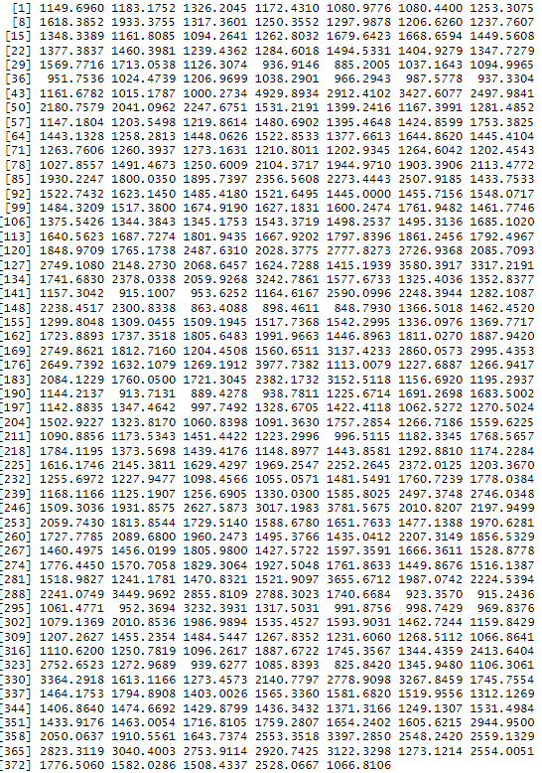
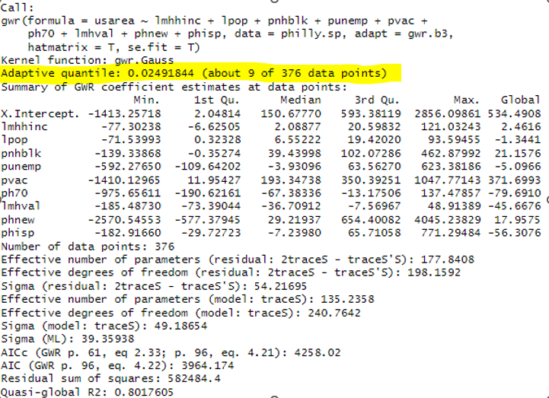
GWR results with adaptive bandwidths
29

Slide 31
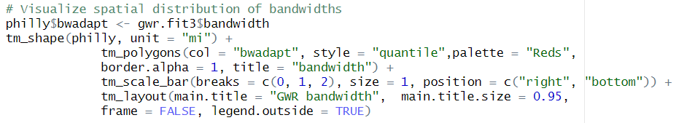
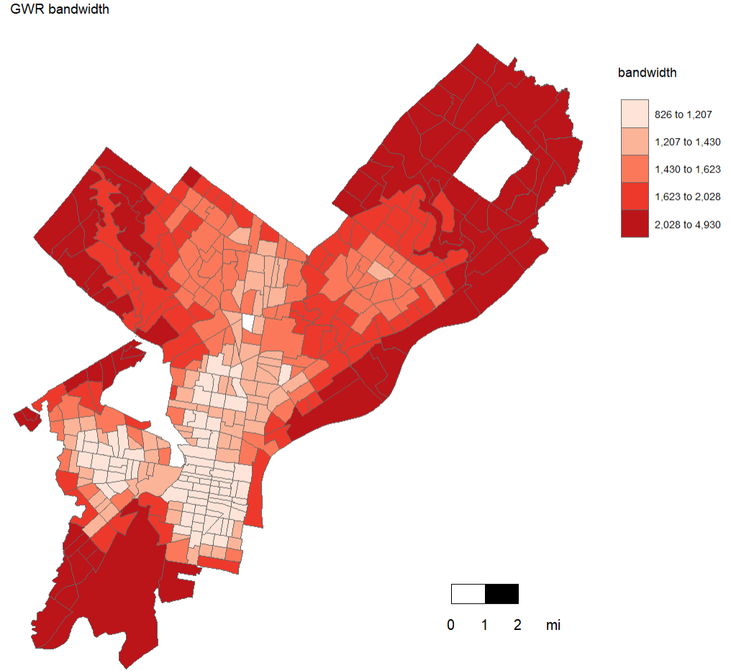
Adaptive bandwidths: spatial distribution
30

Slide 32
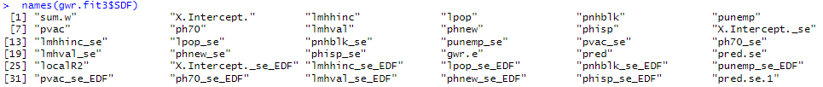
Presenting GWR results
Show the spatial distribution of coefficients for each variable
Show the local R² for each geographical area
SDF is an object within the GWR object containing the 376 regression model estimates for each independent variable
31

Slide 33
Presenting GWR results
Coefficients and Standard Errors:
"X.Intercept.": Estimated intercept for each location.
"lmhhinc", "lpop", ..., "phisp": Estimated coefficients for each location corresponding to the respective predictor variables.
"_se" suffix indicates standard errors associated with the coefficients.
Other Columns:
"sum.w": Sum of weights used in the GWR estimation for each location.
"gwr.e": Residuals of the GWR model.
"pred": Predicted values from the GWR model.
"localR2": Local R-squared values for each location.
Columns with "_se_EDF" Suffix:
Columns ending with "_se_EDF" pertain to Effective Degrees of Freedom associated with each coefficient.
32

Slide 34
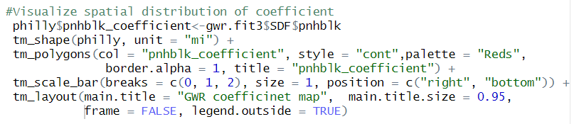
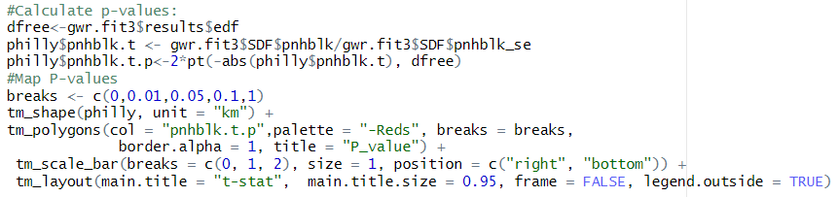
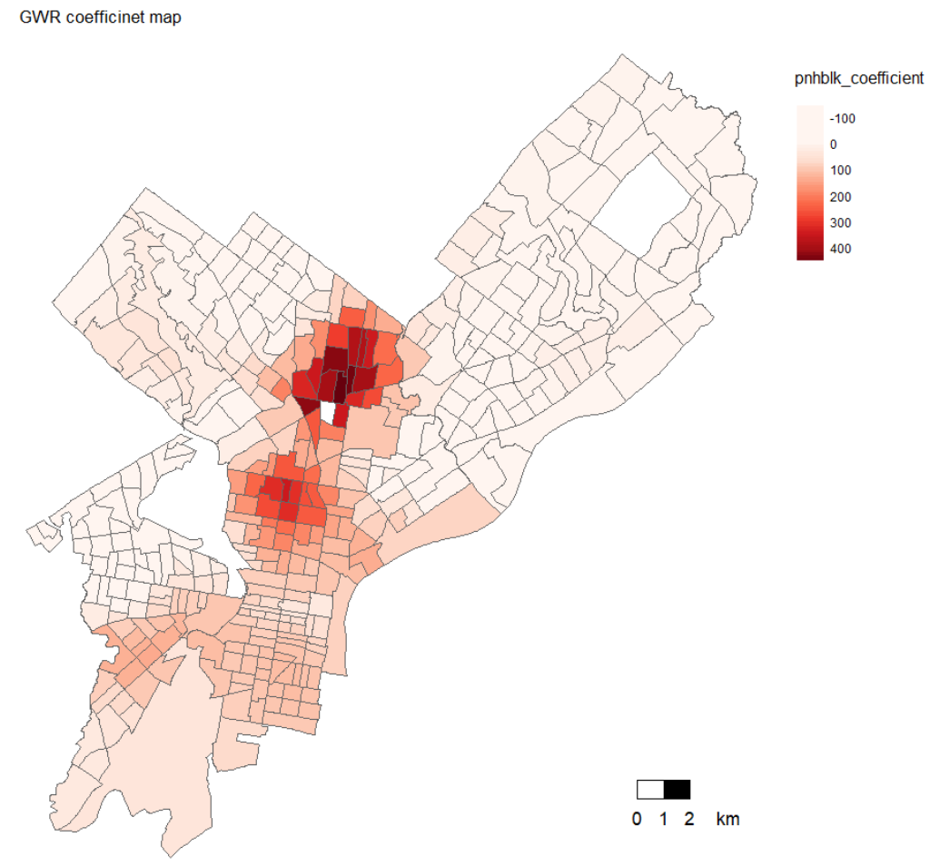
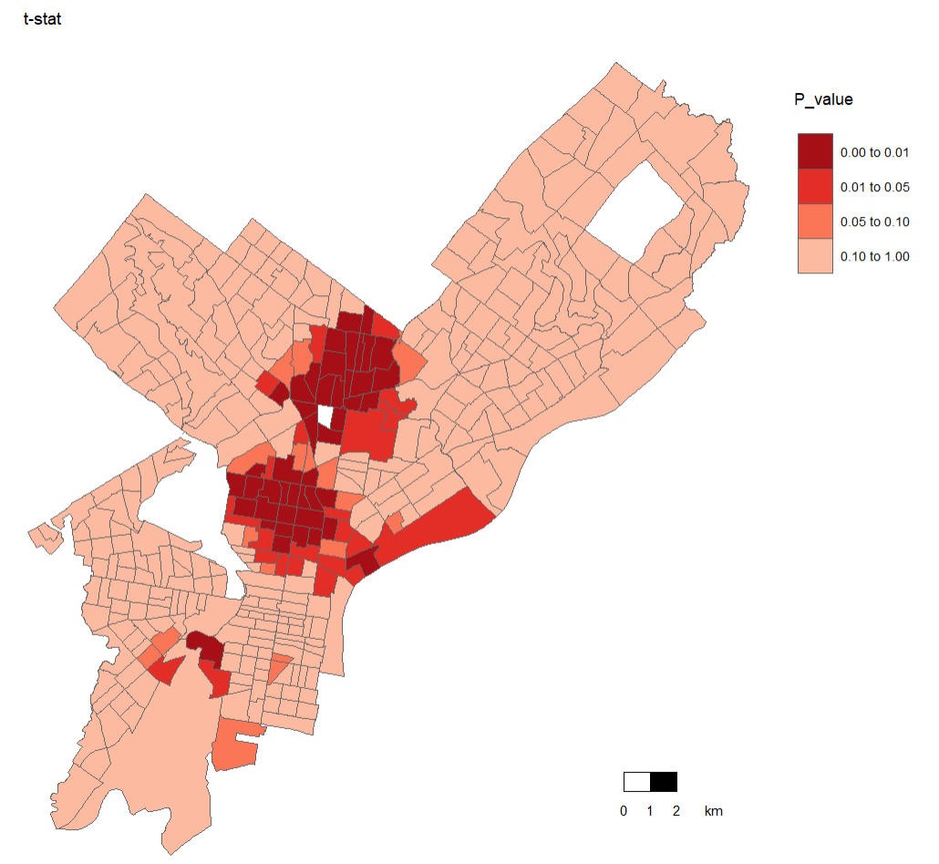
Presenting GWR results
33

Slide 35
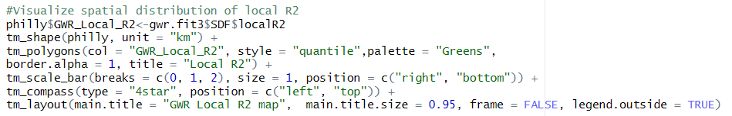
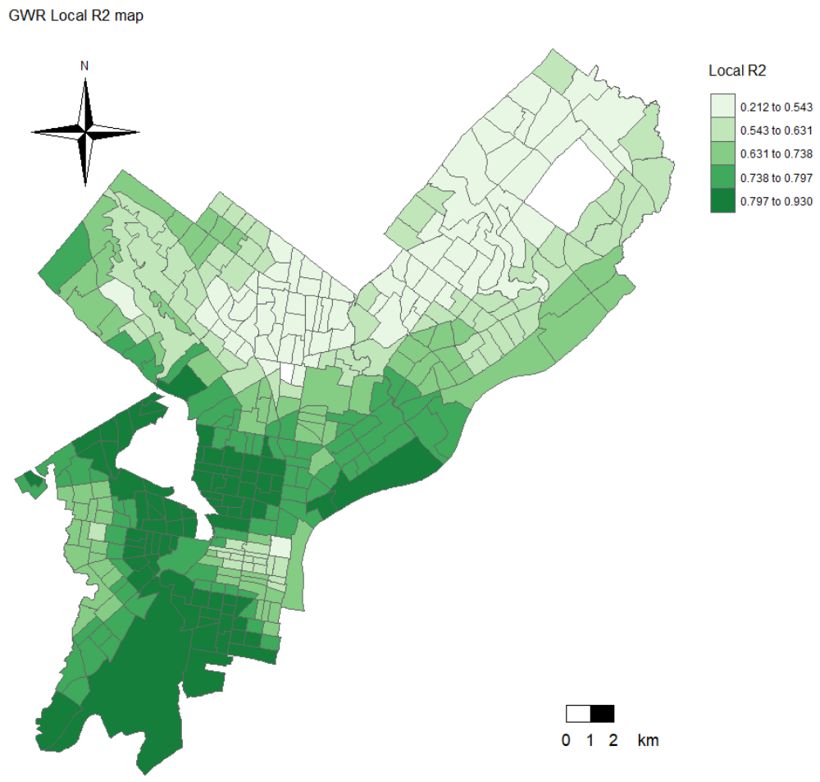
GWR local R² map
The map shows that in some areas the GWR has higher performance.
34

Slide 36
Model fit
The downside of the AIC is that it offers no inferential way of detecting whether differences are statistically different from one another.
The package spgwr has a suite of tests comparing OLS and GWR models under an inferential framework.
These tests are described in Fotheringham et al. (2002). The null in these tests is the OLS and thus a statistically significant test statistic indicates that the GWR provides a statistically significant improvement over an OLS in terms of its ability to match observed values.
Fotheringham, A.S., Brunsdon, C., et al. (2002) Geographically weighted regression: The analysis of spatially varying relationships. Wiley, Hoboken.
35

Slide 37
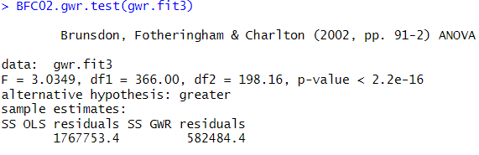
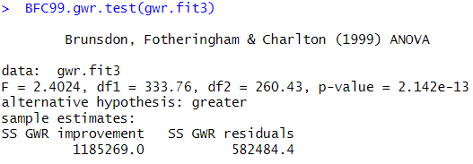


Overall model fit
Fotheringham, A.S., Brunsdon, C., et al. (2002) Geographically weighted regression: The analysis of spatially varying relationships. Wiley, Hoboken.
36

Slide 38

Check the GWR coefficient spatial heterogeneity
Fotheringham, A.S., Brunsdon, C., et al. (2002) Geographically weighted regression: The analysis of spatially varying relationships. Wiley, Hoboken.
37

Slide 39
The End
Behzad Kiani
Research Fellow
UQ Centre for Clinical Research, The University of Queensland, Brisbane, Australia
Email: B.Kiani@uq.edu.au
38

